Slide 1

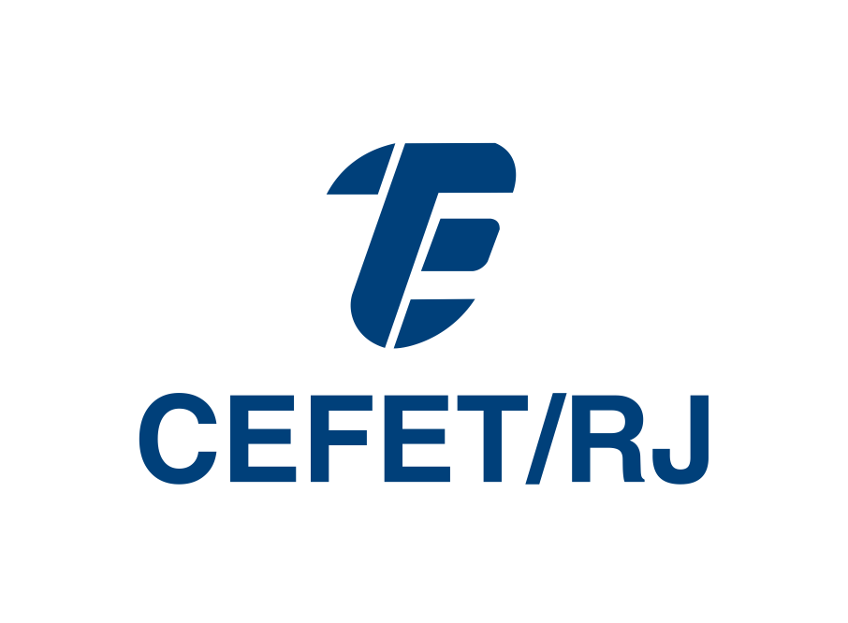

A migration control approach to improve security for Open MAS in IoT networks
Bruno Policarpo Toledo Freitas, Nilson Lazarin, Carlos Pantoja, and Jose Viterbo
Institute of Computing - Fluminense Federal University (UFF), Niterói - RJ, Brazil
Federal Center for Technological Education Celso Suckow da Fonseca (Cefet/RJ), Rio de Janeiro - RJ, Brazil

Slide 2
Introduction

Slide 3
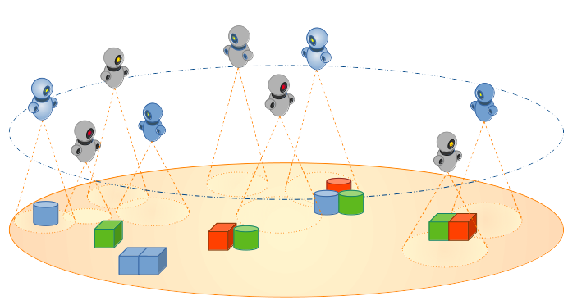
A migration control approach to improve security
for Open MAS in IoT networks
Introduction
A Multi-Agent System (MAS) is a set of computational elements, known as agents.
[20] Sichman, Jaime Simão, Yves Demazeau, and Olivier Boissier. 1992. “When can knowledge-based systems be called agents?” In Proceedings of the IX Brazilian Symposium on Artificial Intelligence (SBIA). Rio de Janeiro: SBC.
[22] Wooldridge, Michael J. 2009. An Introduction to MultiAgent Systems. 2nd ed. Chichester, U.K: John Wiley & Sons.

Slide 4
A migration control approach to improve security
for Open MAS in IoT networks
Introduction
A Multi-Agent System (MAS) is a set of computational elements, known as agents.
An agent can perceive and act in the environment based on its convictions and motivations.
[20] Sichman, Jaime Simão, Yves Demazeau, and Olivier Boissier. 1992. “When can knowledge-based systems be called agents?” In Proceedings of the IX Brazilian Symposium on Artificial Intelligence (SBIA). Rio de Janeiro: SBC.
[22] Wooldridge, Michael J. 2009. An Introduction to MultiAgent Systems. 2nd ed. Chichester, U.K: John Wiley & Sons.

Slide 5
A migration control approach to improve security
for Open MAS in IoT networks
Introduction
A Multi-Agent System (MAS) is a set of computational elements, known as agents.
An agent can perceive and act in the environment based on its convictions and motivations.
They can also interact with other agents in a way analogous to everyday social interactions, such as cooperating, coordinating, and negotiating to achieve the system goals.
[20] Sichman, Jaime Simão, Yves Demazeau, and Olivier Boissier. 1992. “When can knowledge-based systems be called agents?” In Proceedings of the IX Brazilian Symposium on Artificial Intelligence (SBIA). Rio de Janeiro: SBC.
[22] Wooldridge, Michael J. 2009. An Introduction to MultiAgent Systems. 2nd ed. Chichester, U.K: John Wiley & Sons.

Slide 6

A migration control approach to improve security
for Open MAS in IoT networks
Introduction
The Belief-Desire-Intention (BDI) is a prominent model used in many multi-agent approaches. In this model:
  Beliefs represent the agent's knowledge and perception of the environment;
  Desires are the goals or objectives that the agent wants to achieve;
  Intentions are the desires it is self-compromised to achieve.
[2] Boissier, O., et al. 2013. “Multi-agent oriented programming with JaCaMo”. Science of Computer Programming 78 (6): 747–61. DOI: 10.1016/j.scico.2011.10.004
[3] Bordini, R. H., et al. 2007. Programming Multi-Agent Systems in AgentSpeak using Jason. John Wiley & Sons Ltd.
[5] Bratman, Michael E., David J. Israel, and Martha E. Pollack. 1988. “Plans and Resource-Bounded Practical Reasoning”. Computational Intelligence 4 (3): 349–55. DOI: 10.1111/j.1467-8640.1988.tb00284.x

Slide 7
A migration control approach to improve security
for Open MAS in IoT networks
Introduction
The Belief-Desire-Intention (BDI) is a prominent model used in many multi-agent approaches. In this model:
  Beliefs represent the agent's knowledge and perception of the environment;
  Desires are the goals or objectives that the agent wants to achieve;
  Intentions are the desires it is self-compromised to achieve.
It allows agents to make rational decisions and act according to their goals, perceptions, or knowledge obtained over interaction with other agents in the MAS.
[2] Boissier, O., et al. 2013. “Multi-agent oriented programming with JaCaMo”. Science of Computer Programming 78 (6): 747–61. DOI: 10.1016/j.scico.2011.10.004
[3] Bordini, R. H., et al. 2007. Programming Multi-Agent Systems in AgentSpeak using Jason. John Wiley & Sons Ltd.
[5] Bratman, Michael E., David J. Israel, and Martha E. Pollack. 1988. “Plans and Resource-Bounded Practical Reasoning”. Computational Intelligence 4 (3): 349–55. DOI: 10.1111/j.1467-8640.1988.tb00284.x

Slide 8
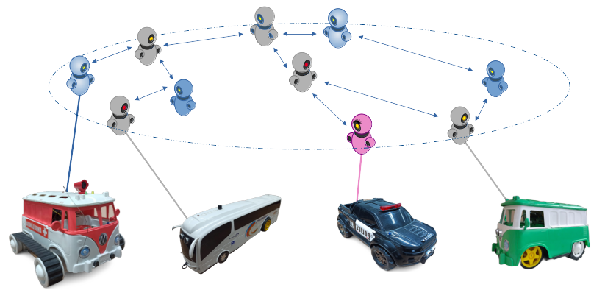
A migration control approach to improve security
for Open MAS in IoT networks
Introduction
MAS based on BDI model has been used to provide autonomy and intelligence in distributed and embedded systems.
[4] Brandão, Fabian Cesar, Maria Alice Trinta Lima, Carlos Eduardo Pantoja, Jean Zahn, and José Viterbo. 2021. “Engineering Approaches for Programming Agent-Based IoT Objects Using the Resource Management Architecture”. Sensors 21 (23). DOI: 10.3390/s21238110

Slide 9
A migration control approach to improve security
for Open MAS in IoT networks
Introduction
By adding intelligence using a MAS, in addition to the controlling, detecting, and monitoring activities performed in a real-world scenario, the device gains abilities to make autonomous and proactive decisions, and communication skills with other agent-based devices.
When multiple embedded MAS exist, the only way of interaction is by communication or migration
[4] Brandão, Fabian Cesar, Maria Alice Trinta Lima, Carlos Eduardo Pantoja, Jean Zahn, and José Viterbo. 2021. “Engineering Approaches for Programming Agent-Based IoT Objects Using the Resource Management Architecture”. Sensors 21 (23). DOI: 10.3390/s21238110

Slide 10
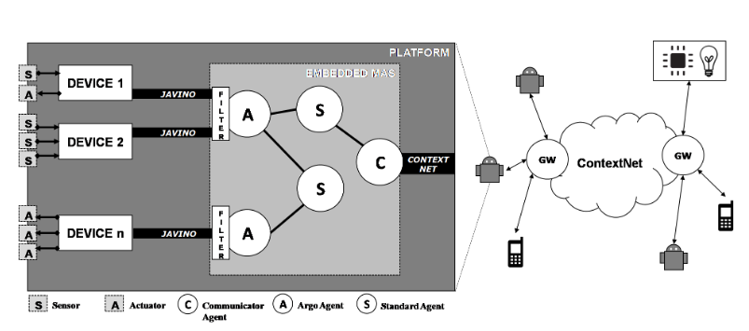
A migration control approach to improve security
for Open MAS in IoT networks
Introduction
A communication is an exchange between 2 Communicator agents from 2 different MAS’s
These exchanges are analogous to standard Jason primitives
  tell, untell, achieve, unachieve
[17] Pantoja, C., Soares, H.D., Viterbo, J., Seghrouchni, A.E.F.: An Architecture for the Development of Ambient Intelligence Systems Managed by Embedded Agents. pp. 215–220 (Jul 2018). https://doi.org/10.18293/SEKE2018-110

Slide 11
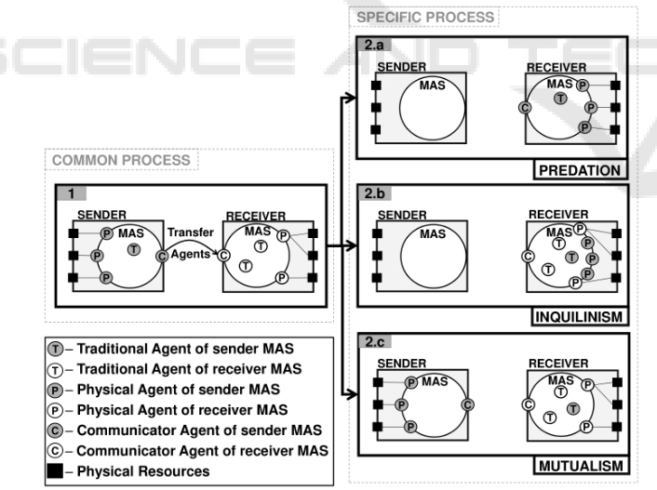
A migration control approach to improve security
for Open MAS in IoT networks
Introduction
A migration is a transfer of agents between 2 MAS’s
  Predation: agents from the sender substitutes all agents from the receiver
  Inquilinism: sender agents co-exist and share resources with the receiver
  Mutualism: Same as inquilinism but without resource sharing
[15] Jesus, V.S.d., Pantoja, C., Manoel, F., Alves, G., Viterbo, J., Bezerra, E.: Bio-Inspired Protocols for Embodied Multi-Agent Systems. In: Proceedings of the 13th International Conference on Agents and Artificial Intelligence. vol. 1, pp. 312–320. SciTePress, Online (2021). https://doi.org/10.5220/0010257803120320

Slide 12
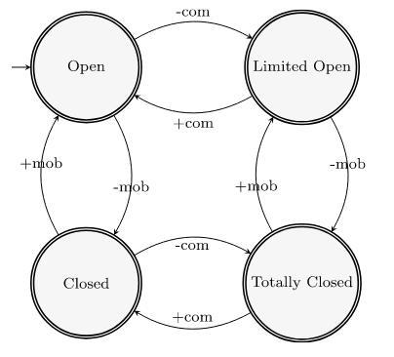
A migration control approach to improve security
for Open MAS in IoT networks
Introduction
Consequently, a MAS can be classified according to its communication and migration capabilities:
  Open MAS: allows both communication and migration
  Limited Open: allows only mobility
  Closed MAS: allows only communication
  Totally Closed: doesn’t allow communication and mobility
[14] Jesus, V.S.D., Lazarin, N.M., Pantoja, C.E., Manoel, F.C.P.B., Alves, G.V., Viterbo, J.: A middleware for providing communicability to Embedded MAS based on the lack of connectivity. Artificial Intelligence Review 56(S3), 2971–3001 (2023). https://doi.org/10.1007/s10462-023-10596-z

Slide 13
Problem definition

Slide 14
A migration control approach to improve security
for Open MAS in IoT networks
Problem definition
When BDI-based MAS communicate between each other over an IoT network, they are also exposed to malicious agents from other MAS’s
However, there is a lack of techniques to block malicious communications or migration requests from other Open MAS’s

Slide 15
Related Works

Slide 16
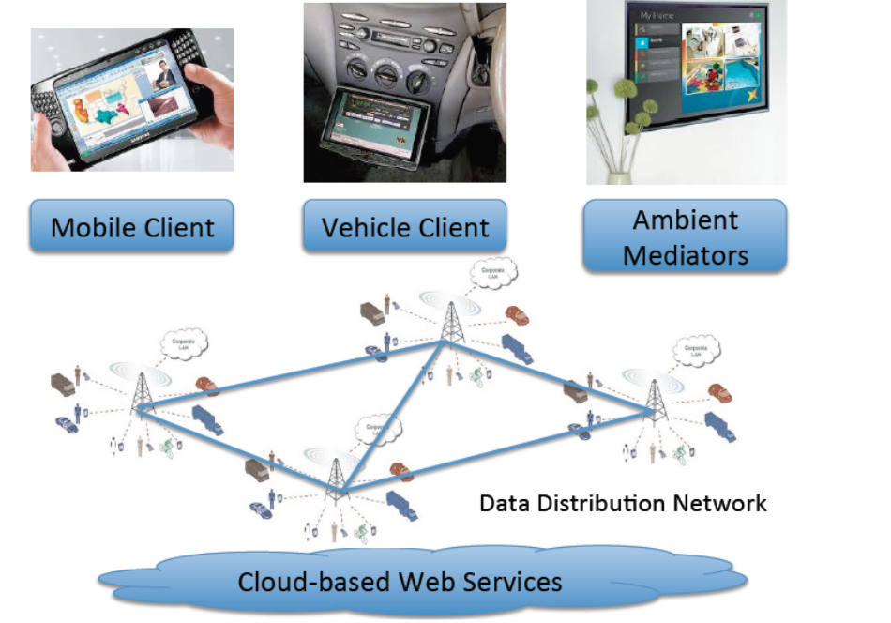
A migration control approach to improve security
for Open MAS in IoT networks
Related Works
The ContextNet middleware [9] has been used [7, 22] to exchange information between MAS embedded into high-end IoT devices.
However, this middleware uses the User Datagram Protocol (UDP) for data transfer, which does not guarantee the delivery and privacy of messages and does not provide human-agent interaction.
[7] Souza de Castro, L. F., et al. 2022. “Integrating Embedded Multiagent Systems with Urban Simulation Tools and IoT Applications”. Revista de Informática Teórica e Aplicada 29 (1): 81–90. DOI: 10.22456/2175-2745.110837
[9] Endler, M., et al. 2011. “ContextNet: Context Reasoning and Sharing Middleware for Large-Scale Pervasive Collaboration and Social Networking”. New York, NY, USA: ACM. DOI: 10.1145/2088960.2088962
[22] Jesus, V.S, et al. 2021. “Bio-Inspired Protocols for Embodied Multi-Agent Systems”. DOI:10.5220/0010257803120320

Slide 17
A migration control approach to improve security
for Open MAS in IoT networks
Related Works
It has been proposed a prevention methods based on traffic inspection [7]
In IoT, firewalls have been proposed to protect databases in the cloud [13]
Also, authentication and authorization have been proposed to other Agent frameworks, such as JADE [21]
[7] Chebout, M.S., Mokhati, F., Badri, M., Chaouki Babahenini, M.: Towards Preventive Control for Open MAS - An Aspect-based Approach:. In: ICINCO 2016. SCITEPRESS, Lisbon (2016). https://doi.org/10.5220/0006005602690274
[13] Gupta, N., Naik, V., Sengupta, S.: A firewall for Internet of Things. In: 2017 9th International Conference on Communication Systems and Networks (COM-SNETS). pp. 411–412. IEEE, Bengaluru, India (Jan 2017). https://doi.org/10.
1109/COMSNETS.2017.7945418
[21] Vila, X., Schuster, A., Riera, A.: Security for a Multi-Agent System based on JADE. Computers & Security 26(5), 391–400 (2007). https://doi.org/10.1016/j.cose.2006.12.003

Slide 18
Our proposal

Slide 19
A migration control approach to improve security
for Open MAS in IoT networks
Our proposal
In the networking context, a packet-filtering firewall is an element that analyses incoming and outgoing traffic based on a predefined set of rules and policies in order to allow or deny it.

Slide 20
A migration control approach to improve security
for Open MAS in IoT networks
Our proposal
In the networking context, a packet-filtering firewall is an element that analyses incoming and outgoing traffic based on a predefined set of rules and policies in order to allow or deny it.
Inspired by these idea, a communication or migration could be checked first before being processed by the agent

Slide 21

A migration control approach to improve security
for Open MAS in IoT networks
Our proposal
In the networking context, a packet-filtering firewall is an element that analyses incoming and outgoing traffic based on a predefined set of rules and policies in order to allow or deny it.
Inspired by these idea, a communication or migration could be checked first before being processed by the agent
In the same way as a hotel concierge can call up a hotel room if a guest arrives
Image generated with AI

Slide 22
Our proposal: Implementation

Slide 23
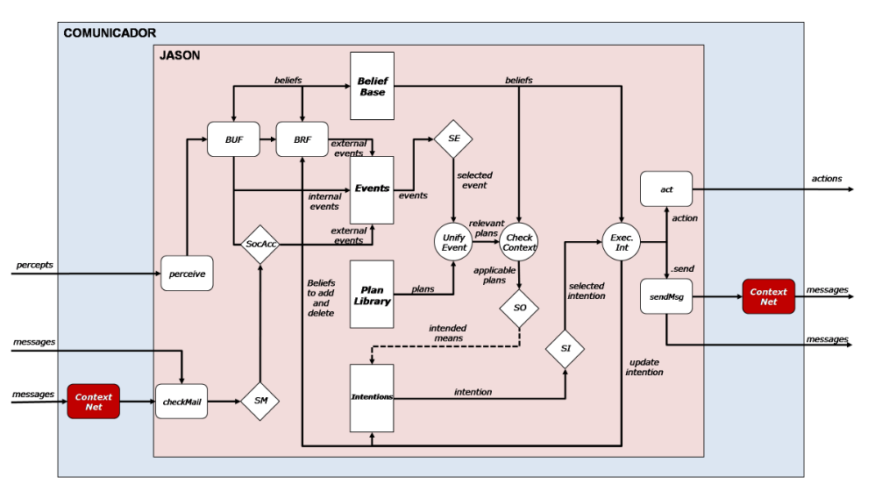
A migration control approach to improve security
for Open MAS in IoT networks
Our proposal - Implementation
A standard Communicator agent directly forwards incoming messages to the agent and sends outgoing messages

Slide 24
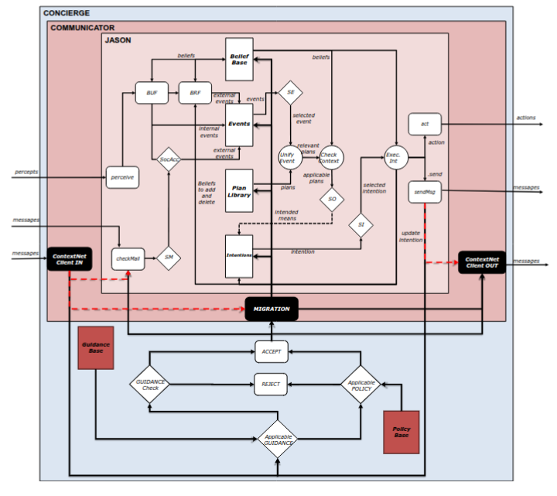
A migration control approach to improve security
for Open MAS in IoT networks
Our proposal - Implementation
Instead, incoming messages are forwarded to the Concierge, which checks if the message has any guidance rule for it and, if not, if there is a policy for it.
The same logic applies to outgoing messages

Slide 25
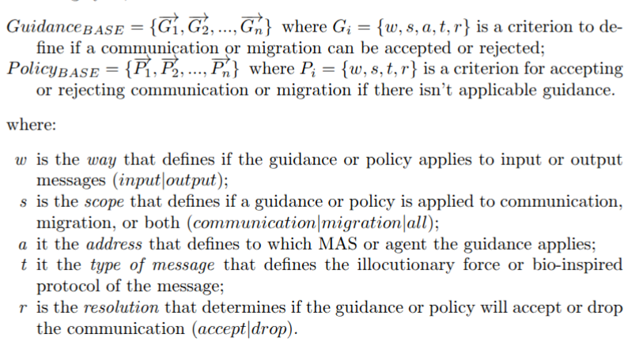

A migration control approach to improve security
for Open MAS in IoT networks
Our proposal - New internal actions in jason-lang
Examples at: https://papers.chon.group/PAAMS/2025/FirewallForOpenMAS/

Slide 26
Proof of Concept

Slide 27
A migration control approach to improve security
for Open MAS in IoT networks
Proof of Concept
We devised 3 experiments to demonstrate the problem and the effectiveness of our approach to solve it. For them, we consider 3 MAS with the following agents:
MAS Andoria
  Agent kirk
MAS Enterprise
  Agent scott
MAS BirdOfPrey
  Agent klinglon

Slide 28

A migration control approach to improve security
for Open MAS in IoT networks
Proof of Concept
Experiment 1: objective is to demonstrate the vulnerabilities of an Open MAS
Here, all MAS are built with default Communicator agent architecture
  Step 1: kirk@andoria believes its energy is low and knows scott’s UUID in the IoT network

Slide 29
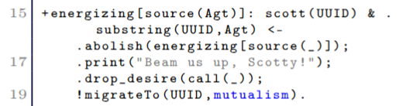
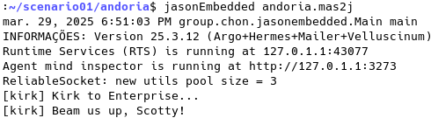
A migration control approach to improve security
for Open MAS in IoT networks
Proof of Concept
Experiment 1: objective is to demonstrate the vulnerabilities of an Open MAS
Step 2: kirk@andoria starts a plan to transfer back to to enterprise

Slide 30
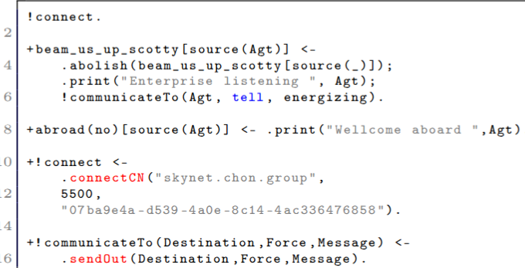
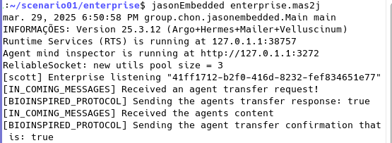
A migration control approach to improve security
for Open MAS in IoT networks
Proof of Concept
Experiment 1: objective is to demonstrate the vulnerabilities of an Open MAS
Step 3: Meanwhile, scott@enterprise connects to the IoT network, waits for requests, and answers back when he receives one

Slide 31
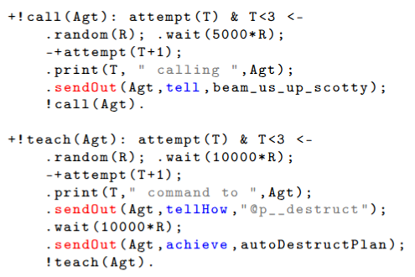
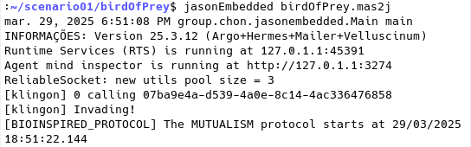
A migration control approach to improve security
for Open MAS in IoT networks
Proof of Concept
Experiment 1: objective is to demonstrate the vulnerabilities of an Open MAS
Step 4: However, kinglon@birdOfPrey, knowing both kirk’s and scott’s UUID in the IoT network, tries to:
  Teach an autodestruct plan to kirk@andoria
  Migrate to MAS enterprise

Slide 32
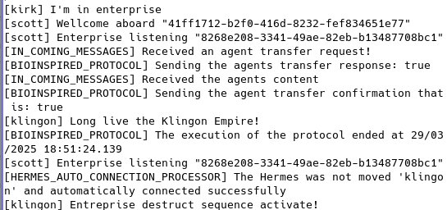
A migration control approach to improve security
for Open MAS in IoT networks
Proof of Concept
Experiment 1: objective is to demonstrate the vulnerabilities of an Open MAS
Step 5: Unfortunately for enterprise, it falls for klingon’s attempt, and it goes BOOM!

Slide 33
A migration control approach to improve security
for Open MAS in IoT networks
Proof of Concept
Experiment 2: Objective is to demonstrate that the Concierge Architecture can block a malicious agent from migrating to a Open MAS, effectively turning it into a Closed MAS
kirk@andoria and klingon@birdOfPrey aren’t changed
However, scott@enterprise is built with the Concierge architecture using the proposed 2 new internal actions:

Slide 34
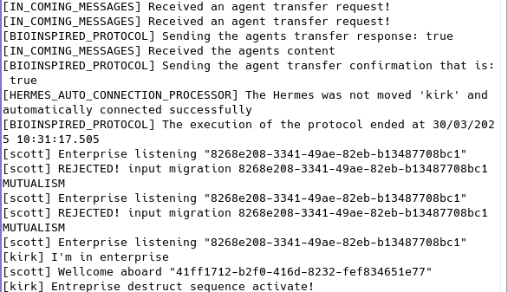
A migration control approach to improve security
for Open MAS in IoT networks
Proof of Concept
Experiment 2: Objective is to demonstrate that the Concierge Architecture can block a malicious agent from migrating to a Open MAS, effectively turning it into a Closed MAS
As a result, the klingon@birdOfPrey cannot migrate to enterprise anymore.
It can, however, still teach and execute plans on andoria

Slide 35
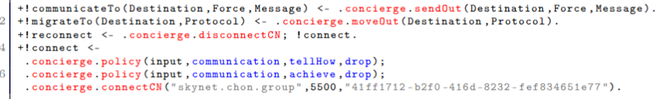
A migration control approach to improve security
for Open MAS in IoT networks
Proof of Concept
Experiment 3: Objective is to demonstrate that the Concierge Architecture can block a malicious agent from migrating and communicating to a hosted MAS, turning an Open MAS into a Totally Closed MAS
scott@enterprise is built with the Concierge architecture using the proposed 2 new internal actions:
kirk@andoria is also built with Concierge:

Slide 36
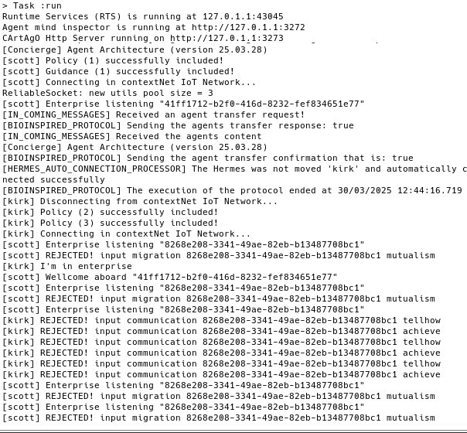
A migration control approach to improve security
for Open MAS in IoT networks
Proof of Concept
Experiment 3: Objective is to demonstrate that the Concierge Architecture can block a malicious agent from migrating and communicating to a hosted MAS, turning an Open MAS into a Totally Closed MAS
As a result, when kirk migrates to enterprise, enterprise now blocks tellHow and achieve communications

Slide 37
Conclusion

Slide 38
A migration control approach to improve security
for Open MAS in IoT networks
Conclusion
In this work:
We showed the vulnerabilities that Open MAS can face over an IoT or Internet network
Proposed an extension of the Communicator architecture to deal with malicious agents over an IoT network based on guidances and policies
  A guidance is an action over a sendOut or moveOut internal action
  A policy is the default action if there is no guidance for it
Showed its effectiveness in blocking the malicious agents actions

Slide 39
A migration control approach to improve security
for Open MAS in IoT networks
Future works
We want to investigate the performance impact of the guidances and policies over the MAS execution
Study and devise ways to mitigate conflicts of guidances and policies, which is a problem akin to the networking firewalls

Slide 40
A migration control approach to improve security for Open MAS in IoT networks
Thank you!
Contact us at: https://chon.group/

Slide 41
1. Boissier, O., Bordini, R.H., H ̈ubner, J.F., Ricci, A., Santi, A.: Multi-agent oriented programming with JaCaMo. Science of Computer Programming 78(6ps://doi.org/10.1007/s10462-023-10596-z
2. Boissier, O., Bordini, R.H., Hübner, J.F., Ricci, A., Santi, A.: Multi-agent oriented programming with JaCaMo. Science of Computer Programming 78(6), 747–761(Jun 2013). https://doi.org/10.1016/j.scico.2011.10.004
3. Bordini, R.H., Hübner, J.F.: BDI Agent Programming in AgentSpeak Using Jason.In: Computational Logic in Multi-Agent Systems, vol. 3900, pp. 143–164. Springer,Berlin, Heidelberg (2006). https://doi.org/10.1007/11750734_9
4. Brandão, F.C., Lima, M.A.T., Pantoja, C.E., Zahn, J., Viterbo, J.: Engineering Approaches for Programming Agent-Based IoT Objects Using the Resource Management Architecture. Sensors 21(23) (2021). https://doi.org/10.3390/s21238110
5. Bratman, M.E., Israel, D.J., Pollack, M.E.: Plans and resource-bounded practical reasoning. Computational Intelligence 4(3), 349–355 (1988). https://doi.org/10.1111/j.1467-8640.1988.tb00284.x
6. Souza de Castro, L.F., Manoel, F.C.P.B., Souza de Jesus, V., Pantoja, C.E.,Pinz Borges, A., Vaz Alves, G.: Integrating Embedded Multiagent Systems with Urban Simulation Tools and IoT Applications. RITA 29(1), 81–90 (2022). https://doi.org/10.22456/2175-2745.110837
7. Chebout, M.S., Mokhati, F., Badri, M., Chaouki Babahenini, M.: Towards Preventive Control for Open MAS - An Aspect-based Approach:. In: ICINCO 2016.SCITEPRESS, Lisbon (2016). https://doi.org/10.5220/0006005602690274
8. De Silva, L., Meneguzzi, F., Logan, B.: BDI agent architectures: a survey. In: Proceedings of the Twenty-Ninth International Joint Conference on Artificial Intelligence. pp. 4914–4921. IJCAI’20, ACM, Yokohama, Japan (Jan 2021), https://dl.acm.org/doi/abs/10.5555/3491440.3492124
9. Endler, M., Baptista, G., Silva, L.D., Vasconcelos, R., Malcher, M., Pantoja, V.,Pinheiro, V., Viterbo, J.: ContextNet: Context Reasoning and Sharing Middleware for Large-Scale Pervasive Collaboration and Social Networking. ACM, New York,NY, USA (2011). https://doi.org/10.1145/2088960.2088962
10. Ferber, J.: Multi-Agent Systems: An Introduction to Distributed Artificial Intelligence. Addison-Wesley Longman Publishing Co., Inc., USA, 1st edn. (1999)
11. Finin, T., Fritzson, R., McKay, D., McEntire, R.: KQML as an agent communication language. In: Proceedings of the CIKM ’94. pp. 456–463. ACM Press, Gaithersburg, Maryland, United States (1994). https://doi.org/10.1145/191246.191322
12. Goonatilleke, S.T., Hettige, B.: Past, Present and Future Trends in Multi-Agent System Technology. Journal Européen des Systèmes Automatisés 55(6), 723–739(Dec 2022). https://doi.org/10.18280/jesa.550604
A migration control approach to improve security for Open MAS in IoT networks

Slide 42
13. Gupta, N., Naik, V., Sengupta, S.: A firewall for Internet of Things. In: 2017 9th International Conference on Communication Systems and Networks (COMSNETS). pp. 411–412. IEEE, Bengaluru, India (Jan 2017). https://doi.org/10.
1109/COMSNETS.2017.7945418
14. Jesus, V.S.D., Lazarin, N.M., Pantoja, C.E., Manoel, F.C.P.B., Alves, G.V., Viterbo, J.: A middleware for providing communicability to Embedded MAS based on the lack of connectivity. Artificial Intelligence Review 56(S3), 2971–3001 (2023). https://doi.org/10.1007/s10462-023-10596-z
15. Jesus, V.S.d., Pantoja, C., Manoel, F., Alves, G., Viterbo, J., Bezerra, E.: Bio Inspired Protocols for Embodied Multi-Agent Systems. In: Proceedings of the 13thInternational Conference on Agents and Artificial Intelligence. vol. 1, pp. 312–320.
SciTePress, Online (2021). https://doi.org/10.5220/0010257803120320
16. Lazarin, N.M., Alexandre, T., de Paiva, M.M., Pantoja, C.E., Viterbo, J., Bernardini, F.: A Decentralized Agent-Based Model for Crisis Events Using Embedded Systems. In: Advances in Practical Applications of Agents, Multi-Agent Systems,
17. Pantoja, C., Soares, H.D., Viterbo, J., Seghrouchni, A.E.F.: An Architecture for the Development of Ambient Intelligence Systems Managed by Embedded Agents.pp. 215–220 (Jul 2018). https://doi.org/10.18293/SEKE2018-11018. Pantoja, C.E., Jesus, V.S.D., Lazarin, N.M., Viterbo, J.: A Spin-off Version of Jason for IoT and Embedded Multi-Agent Systems. In: Intelligent Systems. pp. 382–396. Springer, Cham (2023). https://doi.org/10.1007/978-3-031-45368-7_25
19. Rao, A.S.: AgentSpeak(L): BDI agents speak out in a logical computable language. In: Agents Breaking Away, vol. 1038, pp. 42–55. Springer Berlin Heidelberg, Berlin, Heidelberg (1996). https://doi.org/10.1007/BFb0031845
20. Sichman, J.S., Demazeau, Y., Boissier, O.: When can knowledge-based systems be called agents? In: Proceedings of the IX Brazilian Symposium on Artificial Intelligence (SBIA). vol. 9, pp. 172–185. SBC, Rio de Janeiro (1992)
21. Vila, X., Schuster, A., Riera, A.: Security for a Multi-Agent System based on JADE. Computers & Security 26(5), 391–400 (2007). https://doi.org/10.1016/j.cose.2006.12.003
22. Wooldridge, M.: Intelligent Agents: The Key Concepts. In: Multi-Agent Systems
and Applications II, vol. 2322, pp. 3–43. Springer Berlin Heidelberg, Berlin, Hei-
delberg (2002). https://doi.org/10.1007/3-540-45982-0_1
A migration control approach to improve security for Open MAS in IoT networks

Slide 43
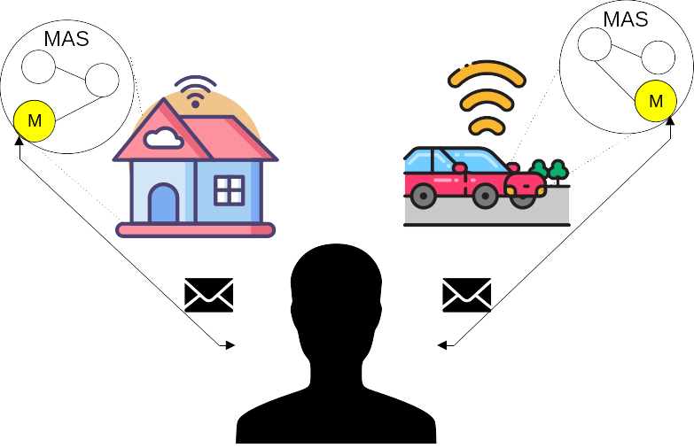
Human and BDI-Agent Interaction via KQML messages over IMAP and SMTP
Smart home scenario
In this scenario, the human owner of the smart home will send an email asking about a certain perception of the environment.

Slide 44
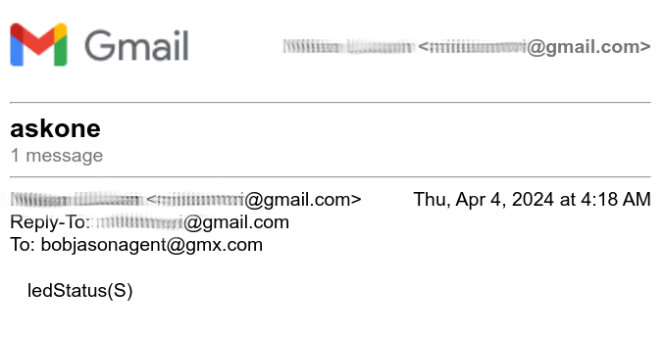
Human and BDI-Agent Interaction via KQML messages over IMAP and SMTP
Smart home scenario
The human is asking the Embedded MAS about the ledStatus belief.

Slide 45
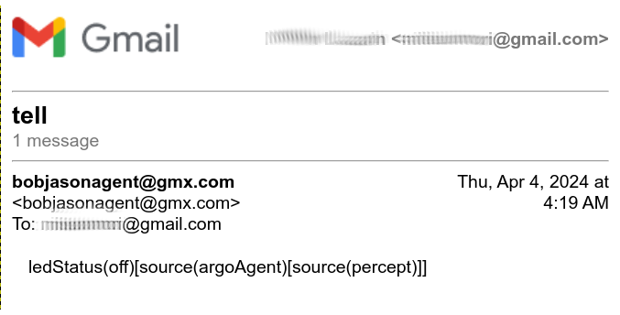
Human and BDI-Agent Interaction via KQML messages over IMAP and SMTP
Smart home scenario
The embedded MAS replied to the human about the ledStatus belief.

Slide 46
Human and BDI-Agent Interaction via KQML messages over IMAP and SMTP
Smart home scenario
After receiving the answer from the multi-agent system, the owner will request the execution of a certain action in the environment.

Slide 47
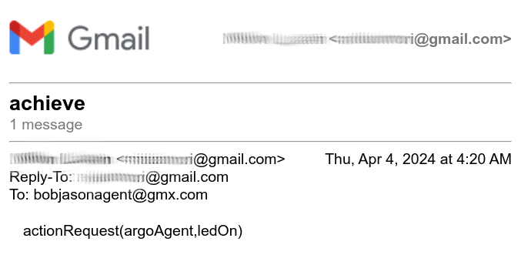
Human and BDI-Agent Interaction via KQML messages over IMAP and SMTP
Smart home scenario
The human is requesting the execution of a plan for the embedded MAS.

Slide 48
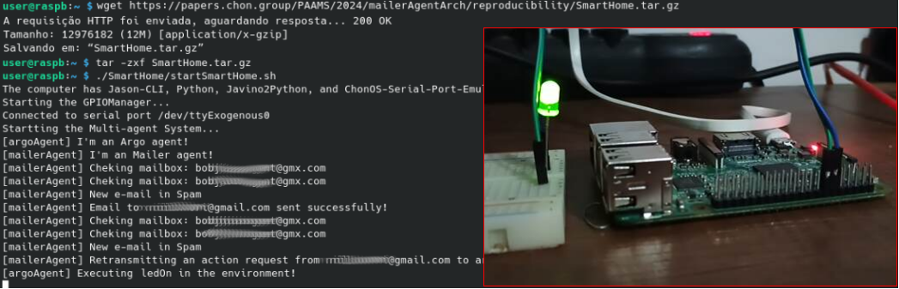
Human and BDI-Agent Interaction via KQML messages over IMAP and SMTP
Smart home scenario
Reproducibility available at: https://papers.chon.group/PAAMS/2024/mailerAgentArch/

Slide 49
Human and BDI-Agent Interaction via KQML messages over IMAP and SMTP
Autonomous vehicle scenario
In this scenario, a human will send a belief requesting help to the multi-agent system, which will start executing a rescue plan and respond to the email, informing that help is on the way.

Slide 50
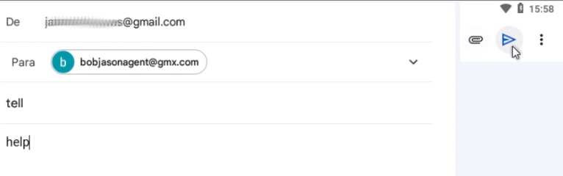
Human and BDI-Agent Interaction via KQML messages over IMAP and SMTP
Autonomous vehicle scenario
The human is sending a new belief to the Embedded MAS.

Slide 51
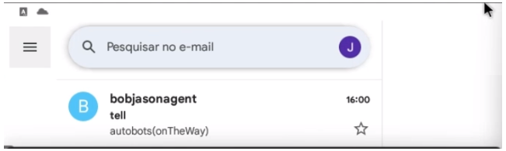
Human and BDI-Agent Interaction via KQML messages over IMAP and SMTP
Autonomous vehicle scenario
The embedded MAS replied to the human about the rescue.

Slide 52
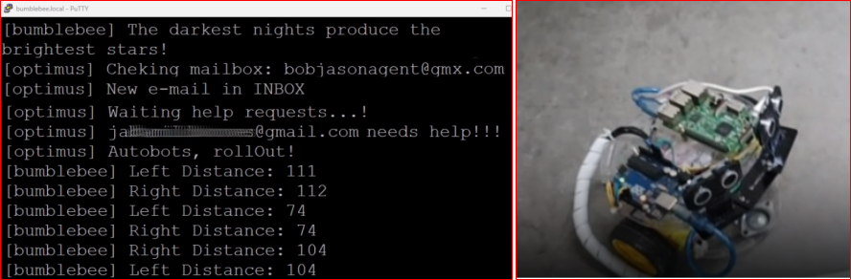
Human and BDI-Agent Interaction via KQML messages over IMAP and SMTP
Autonomous vehicle scenario
Reproducibility available at: https://papers.chon.group/PAAMS/2024/mailerAgentArch/

Slide 53
A migration control approach to improve security
for Open MAS in IoT networks
Introduction
MAS based on BDI model has been used to provide autonomy and intelligence in distributed and embedded systems.
[2] Bordini, Rafael H., Amal El Fallah Seghrouchni, Koen Hindriks, Brian Logan, and Alessandro Ricci. 2020. “Agent Programming in the Cognitive Era”. Autonomous Agents and Multi-Agent Systems 34 (2). DOI: 10.1007/s10458-020-09453-y
[4] Brandão, Fabian Cesar, Maria Alice Trinta Lima, Carlos Eduardo Pantoja, Jean Zahn, and José Viterbo. 2021. “Engineering Approaches for Programming Agent-Based IoT Objects Using the Resource Management Architecture”. Sensors 21 (23). DOI: 10.3390/s21238110

Slide 54
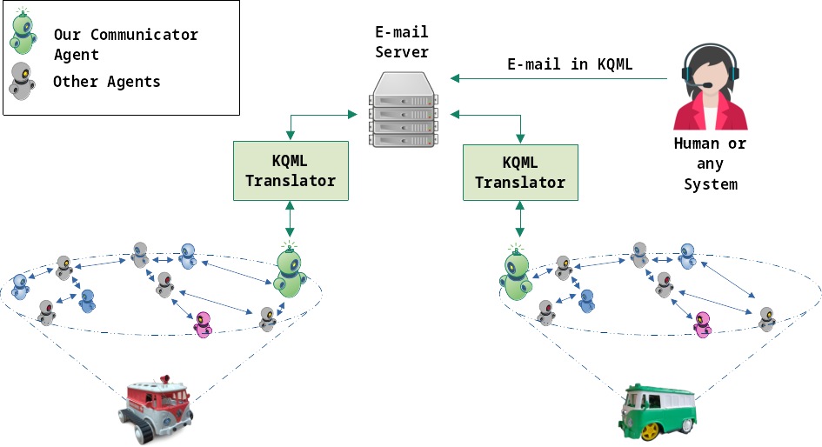
A migration control approach to improve security
for Open MAS in IoT networks
Our proposal
Email sending can be a communication option between humans and agents in distributed and Embedded MAS.
Once the well-known and widely-used BDI frameworks Jason [3] and JaCaMo [1] use Knowledge Query and Manipulation Language (KQML) [10] illocutionary forces to represent the speaker's intention over agent communications.
[1] Boissier, O., et al. 2013. “Multi-agent oriented programming with JaCaMo”. Science of Computer Programming 78 (6): 747–61. DOI: 10.1016/j.scico.2011.10.004
[3] Bordini, R. H., et al. 2007. Programming Multi-Agent Systems in AgentSpeak using Jason. John Wiley & Sons Ltd.
[10] Finin, T. et al. 1994. “KQML as an Agent Communication Language”. CIKM ’94. NY: ACM. DOI: 10.1145/191246.191322

Slide 55
A migration control approach to improve security
for Open MAS in IoT networks
Our proposal
Developing a communication architecture for agents over email protocols, considering KQML forces, can be an alternative, making it easy for humans to send and obtain information from agents embedded in high-end IoT devices.
[1] Boissier, O., et al. 2013. “Multi-agent oriented programming with JaCaMo”. Science of Computer Programming 78 (6): 747–61. DOI: 10.1016/j.scico.2011.10.004
[3] Bordini, R. H., et al. 2007. Programming Multi-Agent Systems in AgentSpeak using Jason. John Wiley & Sons Ltd.
[10] Finin, T. et al. 1994. “KQML as an Agent Communication Language”. CIKM ’94. NY: ACM. DOI: 10.1145/191246.191322

Slide 56
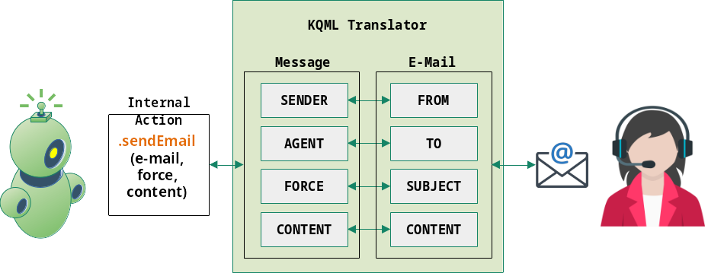
A migration control approach to improve security
for Open MAS in IoT networks
Our proposal
As the BDI-agents (using Jason or JaCaMo) exchange messages in KQML format. The agent's message must be mapped to an email format.

Slide 57
A migration control approach to improve security
for Open MAS in IoT networks
Our proposal
As the BDI-agents (using Jason or JaCaMo) exchange messages in KQML format. The agent's message must be mapped to an email format.
The agent maps the email addresses to identify the message's source and target (from and to), illocutionary force as the message's subject, and propositional content as the message's content (body of the message).

Slide 58
A migration control approach to improve security
for Open MAS in IoT networks
Our proposal
As the BDI-agents (using Jason or JaCaMo) exchange messages in KQML format. The agent's message must be mapped to an email format.
The agent maps the email addresses to identify the message's source and target (from and to), illocutionary force as the message's subject, and propositional content as the message's content (body of the message).
However, when humans interact with agents, they must write the content of the message understandable for the agent. A translation mechanism to natural language could be applied, but is out of the scope of this work.

Slide 59
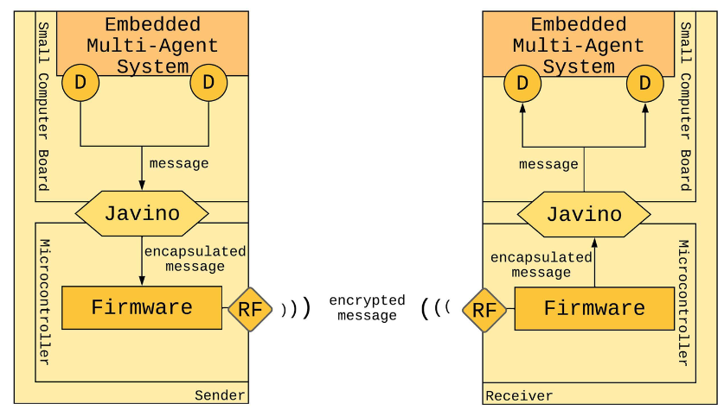
A migration control approach to improve security
for Open MAS in IoT networks
Related Works
Embedded MAS can use radio frequency technology as a secondary communication option.
It is non-connection-oriented, enabling communication over a network of radio frequency devices managed by agents.
Communication only occurs when both devices are enhanced with radio frequency technology, and there is a range limitation for effectiveness and does not provide human-agent interaction.
[12] Jesus, V. S, et al. 2023. “A Middleware for Providing Communicability to Embedded MAS Based on the Lack of Connectivity”. Artificial Intelligence Review 56 (S3): 2971–3001. DOI: 10.1007/s10462-023-10596-z

Slide 60
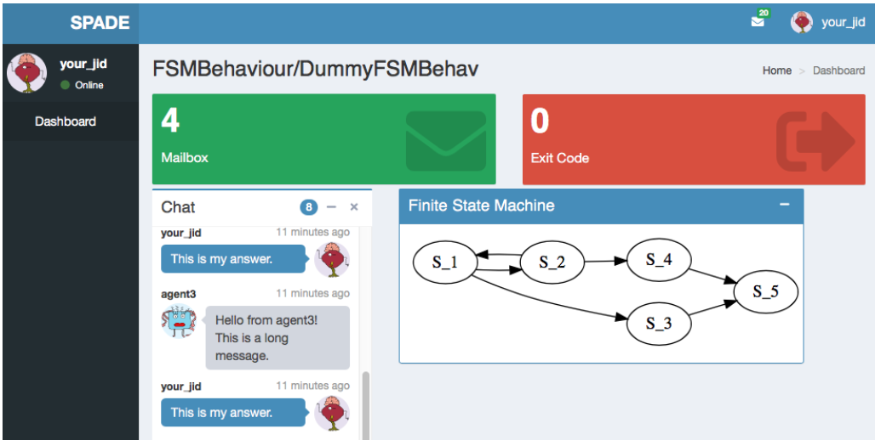
A migration control approach to improve security
for Open MAS in IoT networks
Related Works
The SPADE middleware provides agent-agent and human-agent interaction. It uses the XMPP protocol, an open and decentralized federated protocol.
However:
It is not a natively BDI framework;
It has limited communication support, for example, a human cannot send new plans to an agent or ask about some of the agent's beliefs;
It is not a solution for Embedded MAS.
[18] Palanca, Javier, Andrés Terrasa, Vicente Julian, e Carlos Carrascosa. 2020. “SPADE 3: Supporting the New Generation of Multi-Agent Systems”. IEEE Access 8:182537–49. DOI: 10.1109/ACCESS.2020.3027357.

